Slide 1
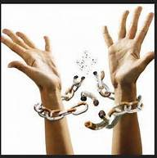
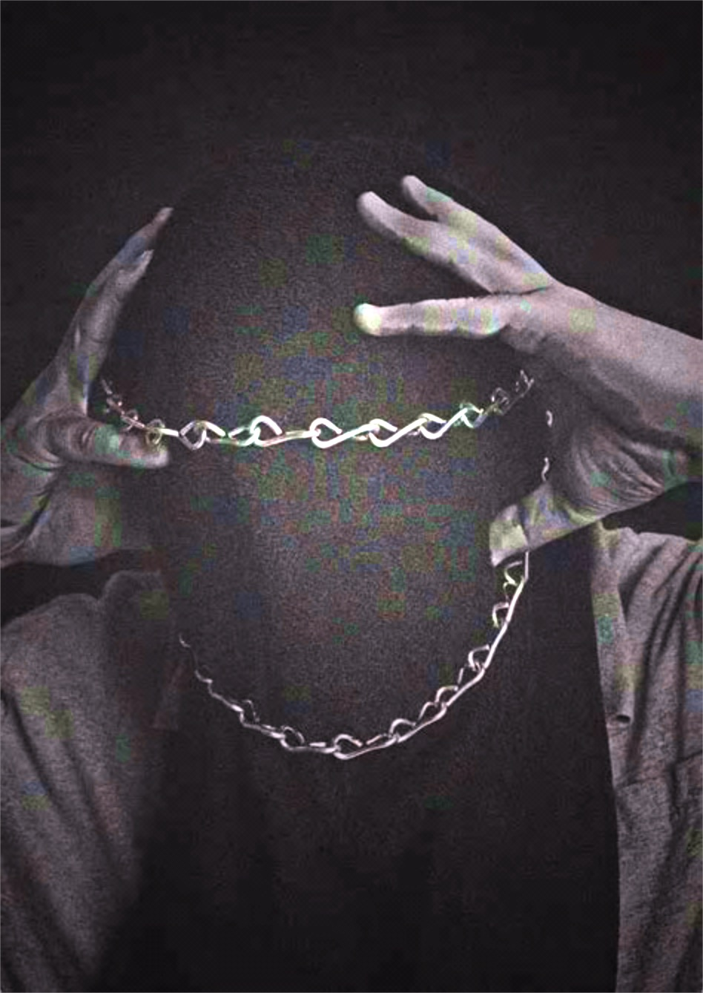
Breaking the Chains of Human Trafficking
Mercy Medical Center
Chains Interrupted
Notes:
Introduce yourself. Ask: “What do you think of when you hear the words “Human Trafficking?” Do you think of the movie “Taken?” Do you think of someone tied up or locked in a basement? While this can certainly happen with Human Trafficking, if we only think that way, we will miss identifying most of the victims. Most of the victims aren’t in Physical chains (like the top picture on this slide)….but in Mental Chains (like the bottom picture). Chains of fear due to threats and acting on those threats. Chains of lies that they deserve what is happening to them, that nobody will believe them, that there is no where for them to go or that they will get arrested or deported. Chains of Stockholm Syndrome as the victim may feel he/she is in love with their captor.
*Sometimes when we talk about this issue, it can bring up feelings or memories that people didn’t know they had – or upset people. If this happens to you, please feel free to step out. Tell a teacher or another trusted adult what you are feeling. It is important to process these feeling and not just “wish they would go away.”

Slide 2
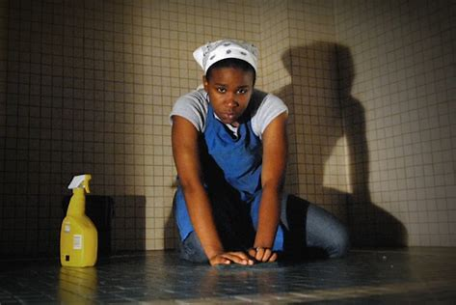
What is Human Trafficking?
Labor Trafficking:
  Making someone provide labor or services through FORCE, FRAUD or COERCION
    Domestic servitude (maid, nanny)
    Agriculture
    Factories
    Restaurants
    Hotels
Notes:
Force: make someone do something against their will, usually by physical force
Fraud: trick someone into doing something, deception, lying
Coercion: persuading someone into doing something – such as threatening them or someone they love with violence

Slide 3
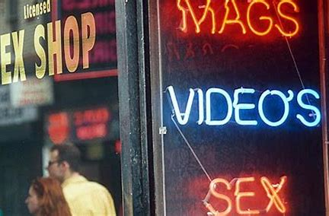
What is human trafficking?
Sex Trafficking
  Making someone provide a service in the sex industry through FORCE, FRAUD or COERCION
    Escort services
    Stripping
    Pornography
    Prostitution
Notes:
A service in the sex industry, does not always have to mean intercourse. It can also involve stripping, acting in a porn film, and other sexual acts. For a commercial sex act, there doesn’t have to be an exchange of money – it can be anything of value (food, clothing, shelter, drugs).

Slide 4

What if the victim
is a minor (<18)?
Notes:
***IF a MINOR is in the commercial sex industry, it is AUTOMATICALLY human trafficking - they don’t need to prove force, fraud or coercion

Slide 5
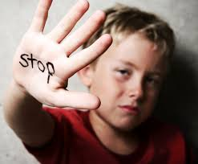
Global perspective
40,300,000 victims worldwide
Sex trafficking:
  80% female
  20% male
  54 % minors
Average age of victims is YOUNG (12-18)
Notes:
Statistics are hard – you can find a lot of different numbers about HT online
Iowa Attorney General’s Office tells us that the average age of victims in Iowa is more like 16-18 years old. The youngest victim Teresa has seen in the US is 18 months. When she traveled to India, she saw many children, as young as 3 and 4 years old being sold for sex.

Slide 6
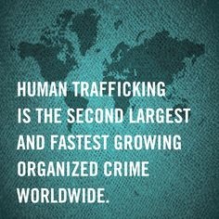
Notes:
Just 5 years ago, HT was the third most lucrative crime in the world. Arms and weapons trafficking was #2. What is the #1 criminal enterprise right now? Drug trafficking. Drug and Human Trafficking often go together. Human Trafficking is slated to become the #1 crime in the world in just 5 years.
Drugs
HT
Weapons
Drugs and HT will match by 2020 – easier to traffick and get away humans

Slide 7
58 Referrals in a year!
Notes:
Mercy Emergency number - Mercy Staff referrals
Survivor Support Group, Foundation 2/ Linn Co Juvenile Detention Center, Local Hospitals’ ED and Child Behavioral Health, CR and Marion public libraries
Local Police Departments, Various Schools (including an elementary school), Various Church Youth Groups
10% - self-referral, 15% law enforcement, 2 calls from NY on runaways to Iowa, 75% likely trafficked, 25% mostly in the grooming process

Slide 8
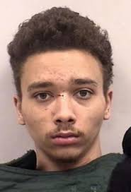
Sad statistics
98-99% of victims never get out of the life
                The average life expectancy once trafficked is SEVEN years
Notes:
The #1 cause of death in HT is homicide, #2 suicide and #3 substance abuse issues
54% buyers – married men with children (it’s a power struggle)
Traffickers may accept as little as $200 extra to be able to kill a person during sex
Traffickers may accept $400 night or they are beaten

Slide 9
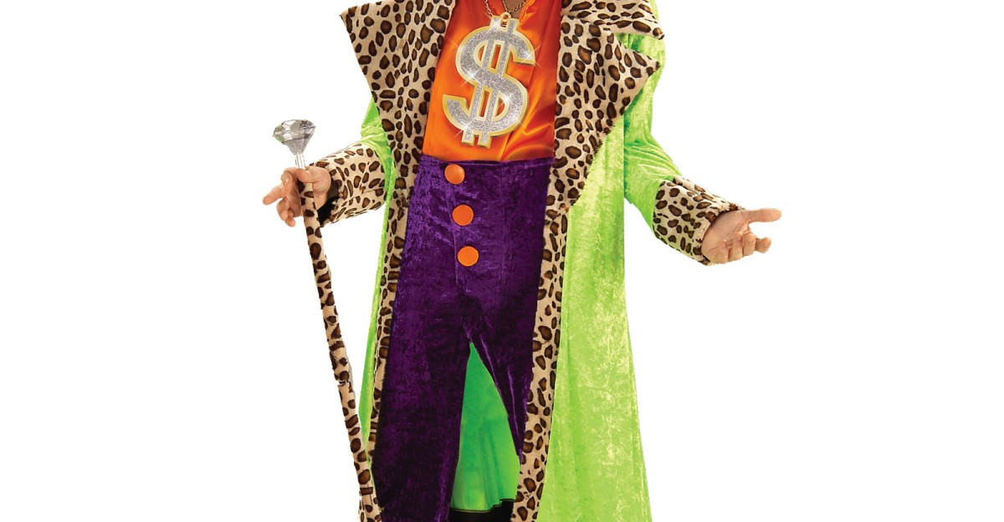
Can you recognize a trafficker?
This isn’t it

Slide 10
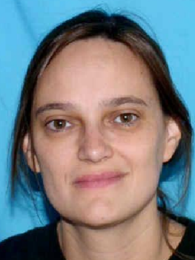
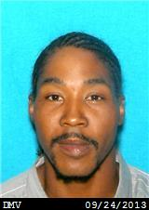
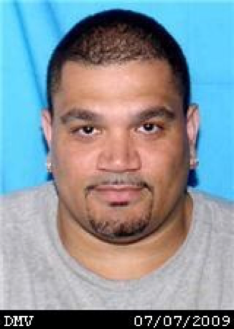
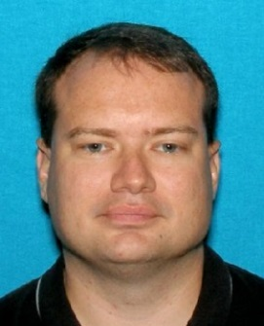
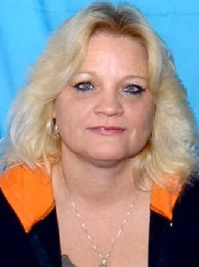
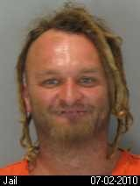
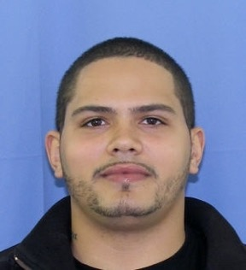
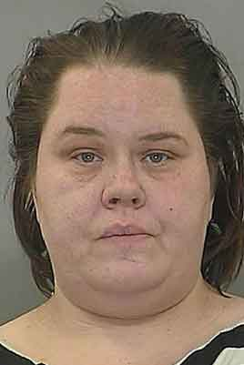
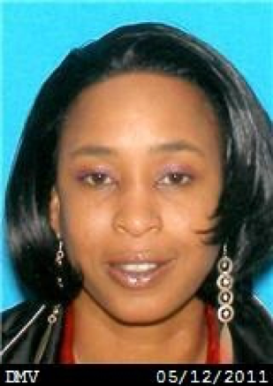
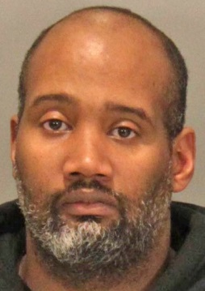
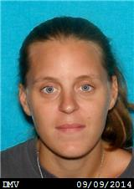
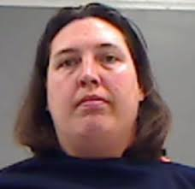
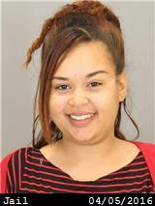
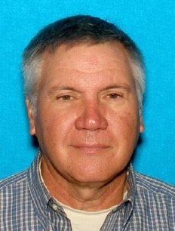
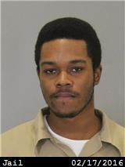
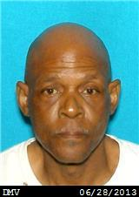
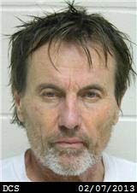
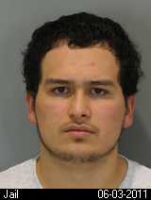
What do Traffickers look like?
Notes:
These are mug shots of traffickers that have been arrested in Iowa and Nebraska. You can there is a wide range in age, socio-economic status and race. Ages are from 18-60 y.o. Some of these people look like you could trust them!

Slide 11
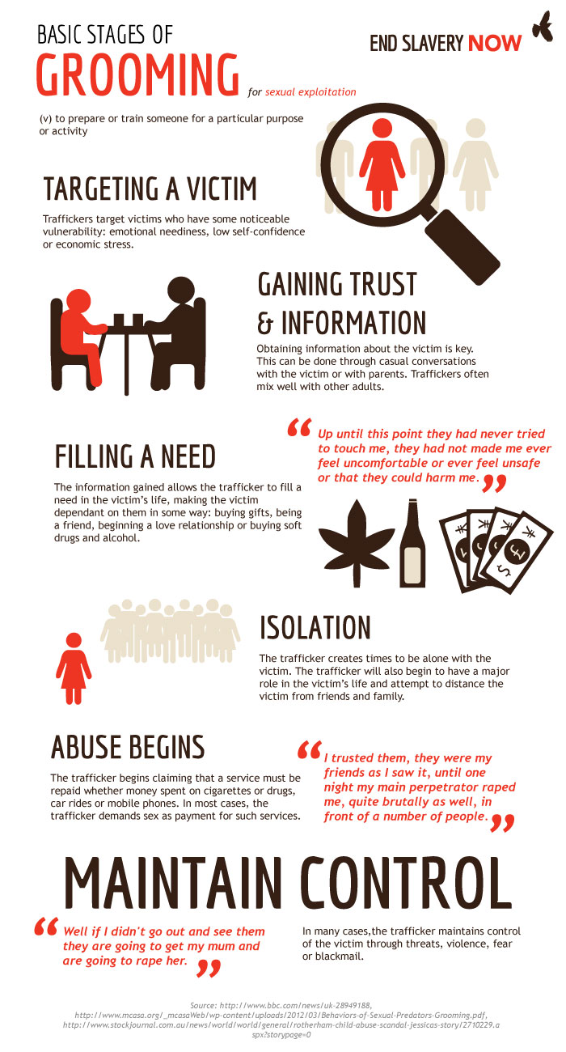
Notes:
*Traffickers target people with some sort of vulnerability – a “need”. Examples of this would be emotional neediness, low self-esteem, economic need, etc.
*They then gain the victim’s trust and get information out of them. Of note, this is often extremely easy. So few people have the gift of listening anymore, victims crave someone who will listen to them.
*Once they have information, they fill the needs the victim has identified (affection, encouragement, material things, drugs/alcohol, etc). Anything to cause the victim to be dependent on them.
*The trafficker will play a greater and greater role in the victim’s life and create distance from their former friends and family. Isolation is key when the abuse begins.
*Because it will. This is how the trafficker gets them to do what they want….and maintains control over them.
Traffickers can be VERY charming and VERY patient. One survivor I know, had a trafficker pretend to be her boyfriend for 6 MONTHS, gained her trust then trafficked her. The thing that confused the girl, and caused her to give him her trust…was the trafficker never tried to sleep with her.
If you hear the words “Family,” “Daddy,” “Wife,” “Wifey” this should make you worry this might be a pimping or trafficking situation. Pimps and traffickers use these words to describe the people in the group that are involved in the trafficking. They suck in kids that crave family with these kind of descriptions of their group.

Slide 12
“where” do they target?
PLACES | INTERNET
School Campuses | Social Media Sites
Foster homes/Residential Tx Centers | Dating Websites
Libraries | Porn Sites
Shopping Centers | Sexting
Parks/Playgrounds | Gaming/other devices with internet cap.
Concerts/Sports/Public Events | Classified Ads (false jobs)
Restaurants/Bars
Strip Clubs
Bus/Train/Metro Stops
Street/Grocery Store
Notes:
Chains Interrupted has worked with a survivor in every category in this table (in our area). There are students who have been recruited in our local school systems, either by kids in school themselves or adults who wait outside the school. Traffickers have paid kids to tell them which students in school would be easy targets.
*Studies show that 64-88% of survivors say they were in the child welfare system when they were trafficked. Some of them were sold by their foster families. Some were recruited out of a shelter.
*Librarians at all our public library have reported trafficking activity attempting to go down at these public places.
*Many survivors of HT state they were recruited at a mall. In the video, Erika was recruited at the food court. Others have reported that the trafficker watched what they shopped for and offered to buy it for them if they couldn’t afford it – thus gaining their trust and making them indebted to them.
*Be very careful when going to parties or bars. Like what happened to Lena and Sarah, someone can easily slip something into your drink, making you unable to fight (or even be aware of) what is happening to you.
*People don’t realize that working in a strip club is a slippery slope to “taking dates” (prostitution). The lure of fast money quickly gets out of control. But who gets that money? Dancers and strippers often have to pay “rent money” to work at the establishment and for drinks the customers buy at a loss to the owner
*Traffickers troll places that kids would go that ran away (bus stops, the street, grocery stores, etc). They target them and offer the scared (and often desperate) kid a job – a place to stay – food – love - whatever it is that runaway needs

Slide 13
Within 48 hours of running away… 1 in 3 teens will be approached for commercial sexual exploitation
Notes:
75% of those approached will be trafficked
The Iowa Attorney General’s Office (2015) says in Iowa, the time teens are lured into prostitution is more like 36 hours
After 3 months away from home, 90% of children will turn to sex to survive (National Incidence Studies of Missing, Runaway and Throwaway Children, 2008)

Slide 14
“Where” do they target?
PLACES | INTERNET
School Campuses | Social Media Sites
Foster homes/Residential Tx Centers | Dating Websites
Libraries | Porn Sites
Shopping Centers | Sexting
Parks/Playgrounds | Gaming/other devices with internet cap.
Concerts/Sports/Public Events | Classified Ads (false jobs)
Restaurants/Bars
Strip Clubs
Bus/Train/Metro Stops
Street/Grocery Store
Notes:
*The internet is the #1 place where people are groomed into trafficking right now! The FBI estimates there are 250,000 child predators online at Any.Given.Moment. People can be anyone they want to be online. They can pretend to be your friend – or your boyfriend/girlfriend. Remember, they break down all your good relationships, making sure they are “the only one who gets you” “the only one who cares about you” “the only one who can or will provide for you.” They reveal their true intentions only after you have left home (isolation). This all can happen on social media sites, dating websites, porn sites, etc.
Maybe you already have an online friend. Be very careful if the following is true!
This is The way traffickers can recruit kiddos online
*One girl Teresa is aware of, met a woman online (Facebook) who continually told the girl her mother was a terrible mother. She systematically broke down the relationship the girl had with her mother in any way she could. One day, the girl posted “I hate my mom” and within 45 MINUTES, the woman had contacted the girl, told her that her mother was horrible, and that the girl could come live with her…she would never treat her that way. The girl went with the woman (keep in mind, she only had an online relationship with her up until this point) and the woman trafficked her.
* Dark Web – deeper underground, anonymous

Slide 15
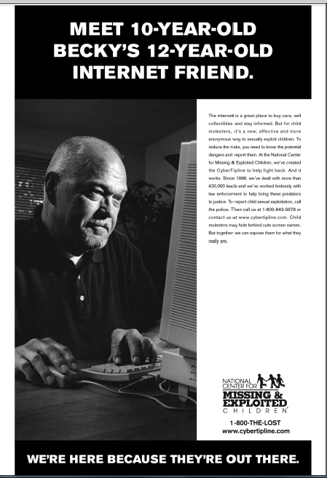
Notes:
People can be anyone they want to be online. How long do you have to know a person online before you can trust them and meet up? You should NEVER go without a trusted adult!

Slide 16
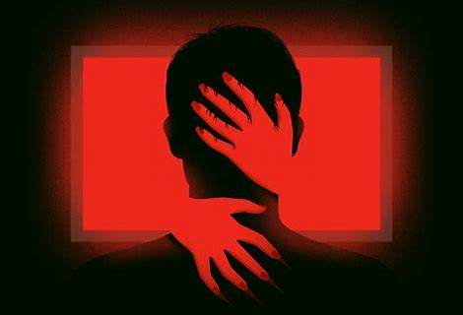
True or false?
Pornography and our
Sexualized Culture contributes to
the demand for
Human Trafficking
Notes:
“Why do they target”

Slide 17
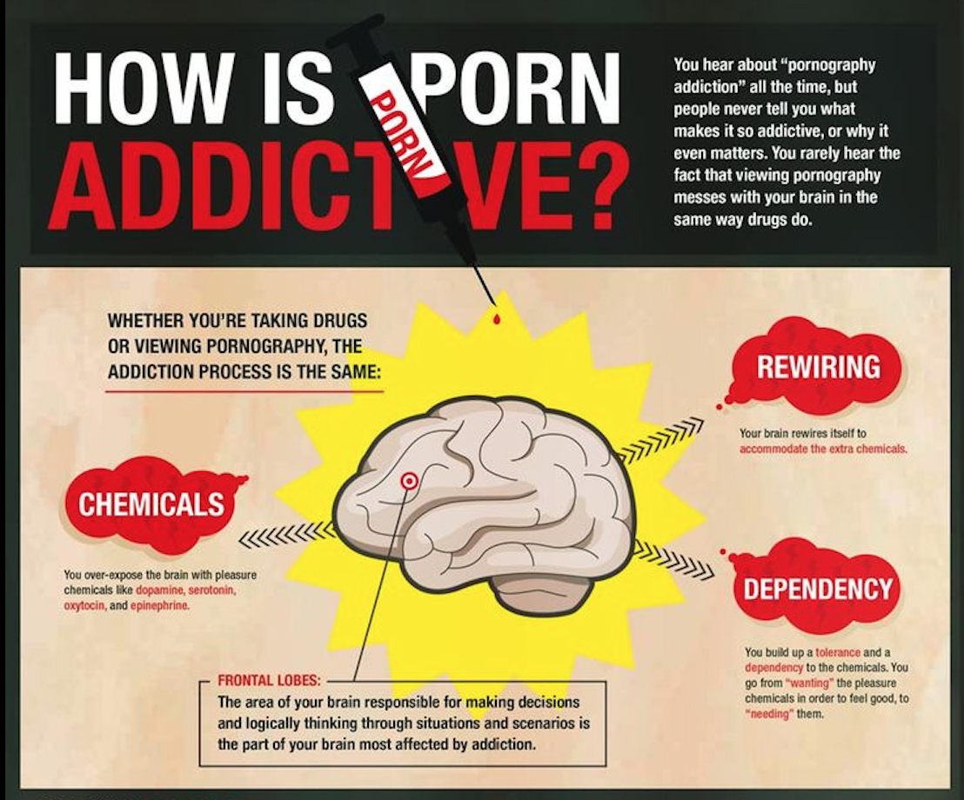
Notes:
TRUE! How? Viewing pornography causes a chemical release in the brain – Dopamine. It is the same chemical released when someone does cocaine or heroin. It makes us feel good. This is why people get addicted to pornography, same as drugs. The trouble with porn is similar to drugs – you need more and more to get that same feeling. In the case of porn, someone starts with viewing ‘typical’ porn online, but the more they view it, the more they have the need to act it out and the more deviant the acts become. The addiction causes them to need harder and harder core porn, and younger and younger partners. There is a direct line between pornography and human trafficking because eventually, they need to act out deviant sex acts they see in pornography with someone who doesn’t have a choice.
Also, porn is FULL of Violence against women- it is the norm – many victims tell us that buyers showed them porn to tell them what they wanted
Viewing porn causes people to view women as objects – causes difficulty in having a normal sexual relationship

Slide 18
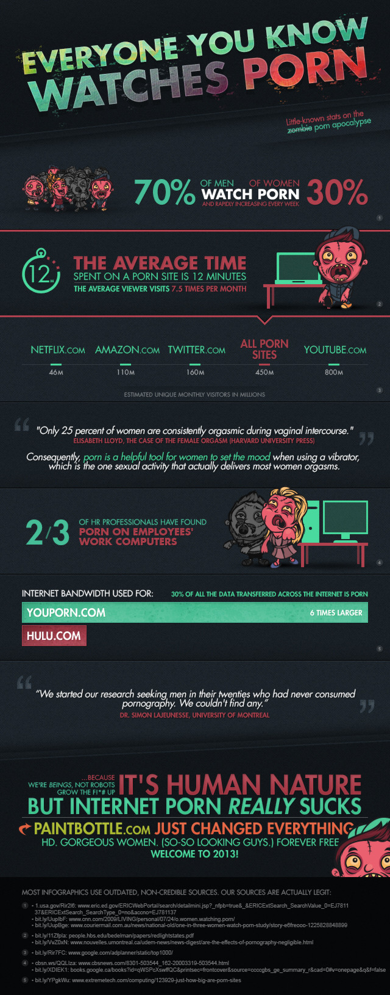

Slide 21
A Big Contributing Problem
  70% of men aged 18-34 visit a porn website regularly
  90% boys exposed to porn by 8-11 yrs old
  (www.thenovusproject.org)
  Every second, almost 30,000 people view pornography
  Every minute, $200,000 is spent on pornography
    (Ana Sutler, 2011. The Connections Between Pornography and Sex Trafficking.)
    www.fightthenewdrug.org

Slide 22
“10% of all pornographic images are of infants and toddlers;
76% are of pre-pubescent children.”
(National Center for Missing and Exploited Children, 2016)

Slide 23
Possible traffic signs
Friend
  Expensive items
  Hotel keys
  Unexplained absences
  Sexual language
  Increased promiscuity
    Behavior
    Dress
  Dominating/older BF
  “Dates” with diff. men
Stranger
  S/S physical abuse
  Malnutrition
  Not allowed to be alone
  Not allowed to speak
  No personal money
  No personal documents
  Disoriented
  Nervous/Fearful
  No eye contact
Notes:
Stranger:
Physical abuse – especially bruises in various stages of healing
Not allowed to speak for themselves
Disoriented – they may not know where they are…where they’ve been…what day it is…
Friend:
Suddenly have expensive items like designer jeans, nails done, flashy jewelry – can be part of the grooming process (lure them in by taking care of them well)
Unexplained absences: You saw an example of someone “Trafficked and Living at Home” on the video. Schools should pay special attention to those students late or absent on Mondays (Monday morning is a high time for use of trafficking victims) or at days at the end of the month (Parents sell to pay rent)

Slide 24

If you see something… say something!
1-888-373-7888
National HT Hotline
1-800-770-1650
Iowa Hotline
319-536-2027
Mercy Medical Center

Slide 25
CHAINs interrupted
Volunteers
  Speaker’s Bureau
    Request a speaker for your work, church, organization, etc.
    Hotel/Motel Project
    School Project
  Events
    Parades, booths, small fundraisers
  Fundraising
    Freedom Gala, Freedom Ride, Stuff Etc., Amazon Smile
    Individual fundraisers
  Missions
    Local (Safe Families, Outreach)
    National (Chicago, Super Bowl)
    International (Guatemala, SE Asia)
  linda@chainsinterrupted.com

